Slide 1



LLM and Real-world Application
Jun Hou
JULY 15, 2025
Notes:
Hello guys, I will talk about the LLM and some real-world applications today.

Slide 2
Agenda
What is Large Language Models (LLMs)?
LLM with Mixture-of-Expert – Efficient and Powerful
Multimodal LLM – Multimodal is how people seen the world
LLM Application – Real-world Challenges

Slide 3
What is Large Language Models (LLMs)?
Notes:
Now, lets first understand what is llms.

Slide 4
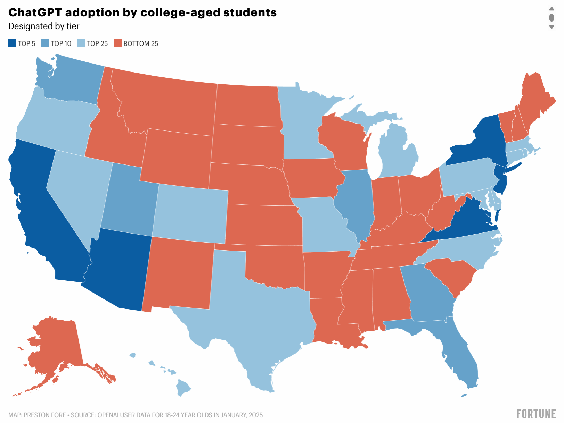
GPT is our good teacher!
- What is LLM looks like and how does LLM reply to us?
- What is the underlying task, other than the classification and regression?
https://www.pewresearch.org/short-reads/2025/01/15/about-a-quarter-of-us-teens-have-used-chatgpt-for-schoolwork-double-the-share-in-2023/
Notes:
We are all familiar with the Chatgpt, and for some people, it is already a good teacher or a good assistant that can help us improve the efficiency for many tasks. From the report, we can know that Chatgpt adoption by college aged students is around Top25 in Virginia.
But, not everyone knows what is LLM looks lke and how does LLM reply to us. Additionally, what is the underlying task that the GPT is performing, since we can easily know it is not the classification or regression tasks we are familiar with.

Slide 5
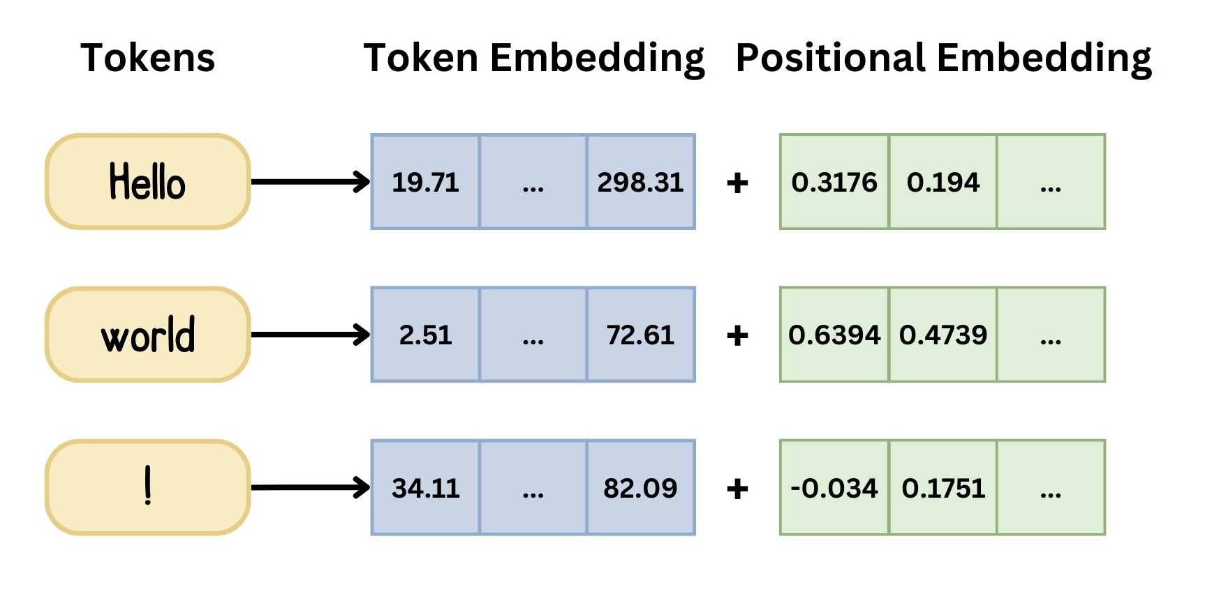
Text Input
Tokenization
Contextual Embedding
Position Embedding
Numerical Embedding
Prepare Input for Language Models
Natural Language Processing --> ['Natural', 'Language', 'Processing']
Notes:
To make it easy understand, let me first explain with the general language model with one of the most famous “transformer” architecture in the Natural Language Processing domain. The workflow shows how the human understandable input is converted to what the model can process. The textual input is first converted to the different segmentations, which is called “tokenization”, then these words in the sequence gets an embedding, which is mapped to numerical representation values, capturing its meaning and position in the sentence. This conversion from tokens to the numerical embedding is performed by Encoder, and this process is known as embedding, and the process to convert back to the words is done by Decoder.

Slide 6
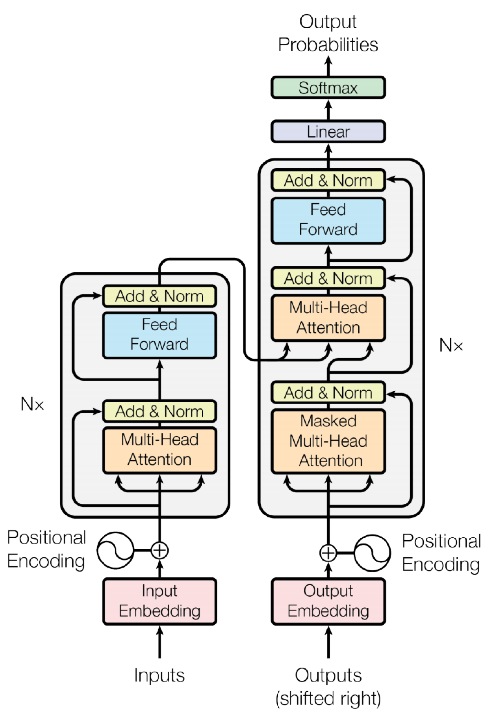
Transformer Overview
Attention is all you need. 2017. Aswani, Shazeer, Parmar, Uszkoreit, Jones, Gomez, Kaiser, Polosukhin https://arxiv.org/pdf/1706.03762.pdf
Can understand the contextual dependency between words
Task: machine translation with parallel corpus
Predict each translated word
Final cost/error function is standard cross-entropy error on top of a softmax classifier
Christopher Manning
Notes:
Now, let’s take a look at the entire architecture of the Transformer.
What makes it so powerful is not justit can handle long input sequences, often up to 512 tokens or more—but also its ability to understand contextual relationships between words across a whole paragraph or even multiple sentences.
Let’s imagine a task like machine translation. If we feed in a sentence in English, the goal is to predict the corresponding sentence in another language, like French or Chinese.
To do this, the model learns to predict one word at a time in the target language. At each step, it outputs a probability distribution—that’s what we see on top of the model—a softmax layer, which tells us how likely each possible word is to come next.
And during training, we use something called cross-entropy loss to compare the model’s prediction with the actual correct word. This is how the model learns.
Next, we’ll talk more details in to understand how the two main parts—the encoder and the decoder—actually work.

Slide 7
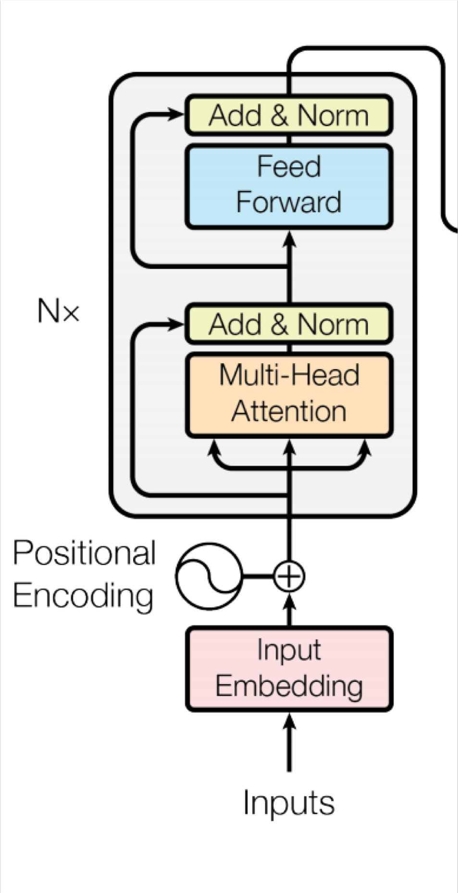
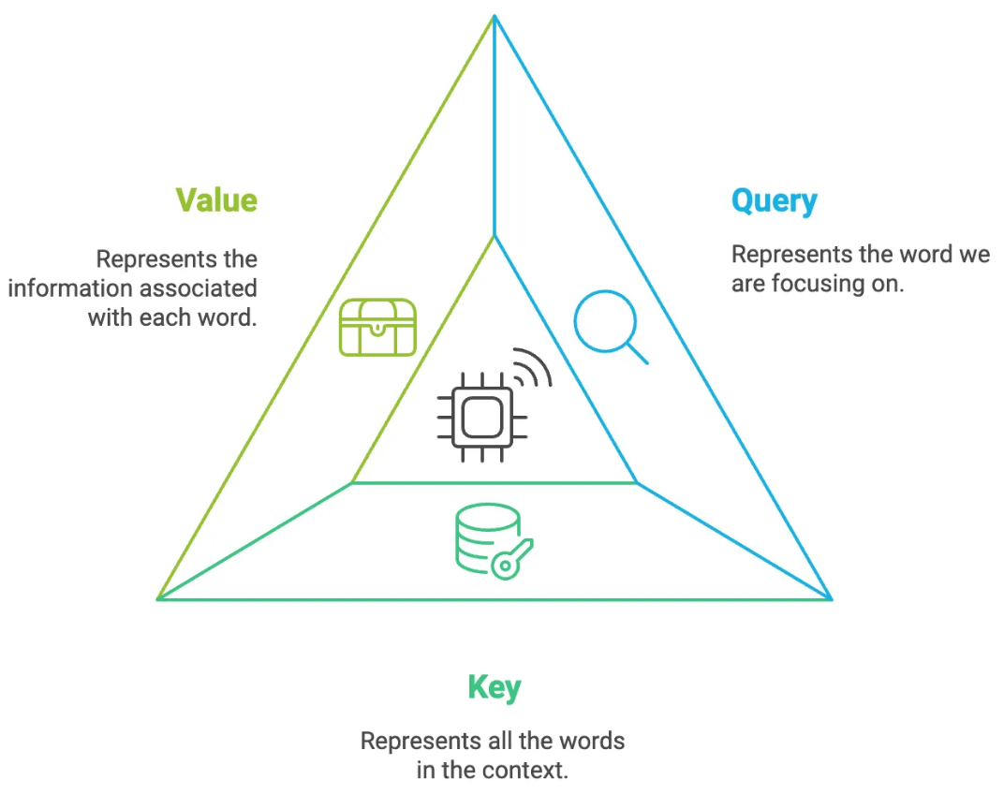
Transformer Encoder
For encoder, at each block, we use the same Q, K and V
from the previous layer
Blocks are repeated 6 times (in vertical stack)
Christopher Manning
Notes:
The encoder is the first half of the transformer. Its job is to convert human-readable language into a machine-friendly representation.
Now, to make this more efficient, the transformer uses multiple encoder blocks working in parallel—this is part of what makes it so fast and scalable. Inside each block, we use something called the attention mechanism, powered by three key components:
Query, Key, and Value—or Q, K, and V.
Here’s a simple way to think about them:
Query is the current word asking a question. It says, ‘What am I looking for in this sentence?’
Key is every word in the sentence saying who can offer the information
Value is the actual information attached to each word, like its meaning or role.
So, every word compares its query to all the keys, and gathers information from the values it finds most relevant.
This helps the model understand not just the meaning of individual words, but how they relate to one another in context

Slide 8


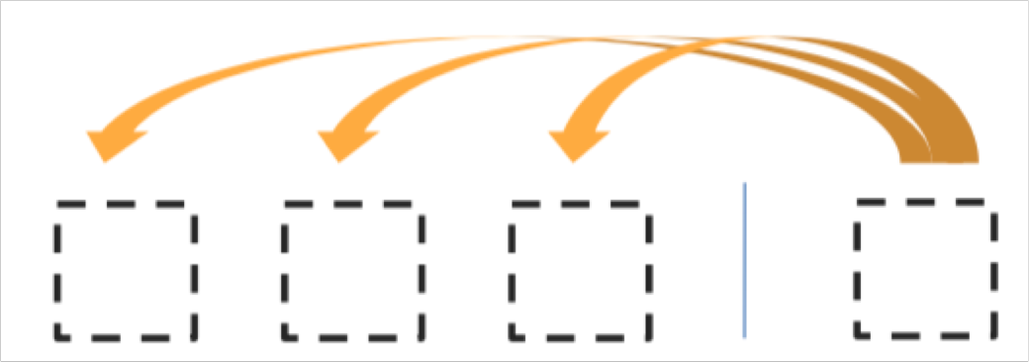
Transformer Decoder
Decoder self-attention on previously generated outputs:
Encoder-Decoder Attention, where queries come from previous decoder layer and keys and values come from output of encoder
Blocks repeated 6 times also
Christopher Manning
Notes:
Now, let’s move on to the decoder.
The decoder’s job is to take that internal representation from the encoder, and generate output, one word at a time.
At each step, the decoder looks at two things:
What words it has already generated so far
What it learned from the encoder about the input sentence
Using another round of attention, the decoder decides what the next word should be. And just like the encoder, it also uses Q, K, and V to help focus on the right context
(read slides)

Slide 9
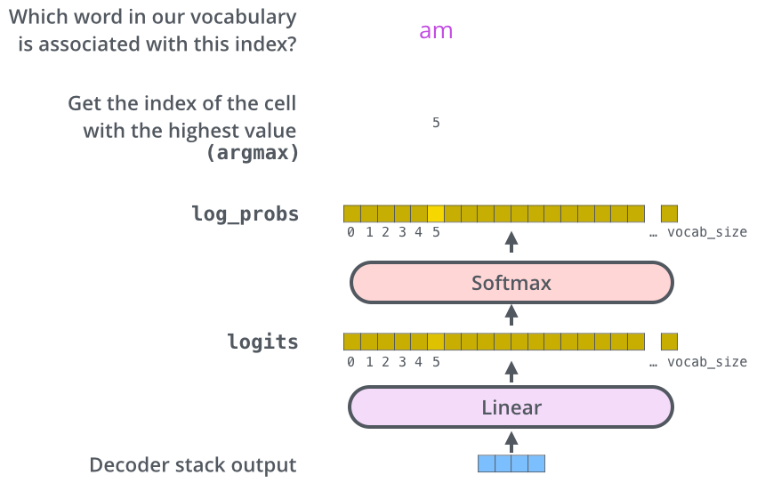
Encoder-Decoder
https://jalammar.github.io/illustrated-transformer/
Notes:
Now that we’ve covered most of the concepts on the encoder side, we basically know how the components of decoders work as well. But let’s take a look at how they work together.
The encoder start by processing the input sequence. The output of the top encoder is then transformed into a set of attention vectors K and V. These are to be used by each decoder in its “encoder-decoder attention” layer which helps the decoder focus on appropriate places in the input sequence. The following steps repeat the process until a special symbol is reached indicating the transformer decoder has completed its output. The output of each step is fed to the bottom decoder in the next time step. And just like we did with the encoder inputs, we embed and add positional encoding to those decoder inputs to indicate the position of each word.
The decoder stack outputs a vector of numbers. How do we turn that into a word? That’s the job of the final Linear layer which is followed by a Softmax Layer.
The Linear layer is a simple fully connected neural network that projects the vector produced by the stack of decoders, into a much, much larger vector called a logits vector.
Let’s assume that our model knows 10,000 unique English words (our model’s “output vocabulary”) that it’s learned from its training dataset. This would make the logits vector 10,000 cells wide – each cell corresponding to the score of a unique word. That is how we interpret the output of the model followed by the Linear layer.
The softmax layer then turns those scores into probabilities (all positive, all add up to 1.0). The cell with the highest probability is chosen, and the word associated with it is produced as the output for this time step.

Slide 10
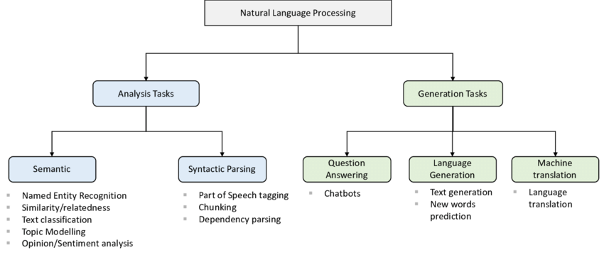
Category of NLP Tasks
Two Broad Categories
https://www.researchgate.net/figure/NLP-Tasks-Categorized-in-Two-Broader-Categories-Analysis-Tasks-light-blue-and_fig4_343323519
Notes:
After learned the most important architecture, the transformer, let’s take see what is the task we are perform. Here is the category of NLP tasks.

Slide 11
Category of NLP Tasks
https://www.researchgate.net/figure/NLP-Tasks-Categorized-in-Two-Broader-Categories-Analysis-Tasks-light-blue-and_fig4_343323519
Notes:
When we chat with an LLM like ChatGPT, it’s doing a text generation task — predicting one word at a time to generate a full response.
Both question answering and language generation involve producing a response, but the goals are slightly different:
For QA task, The model tries to find a specific answer from a given context or its trained knowledge. Q: What is the capital of France? A: Paris → The output is short and factual.
For language generation task, The model is more open-ended — it tries to generate long text that makes sense in context. Prompt: Tell me a story about a cat who goes to space. Response: Once upon a time, there was a curious cat named Pocky, called the worker at SpaceX… → There’s no single “correct” answer—just creativity.

Slide 12
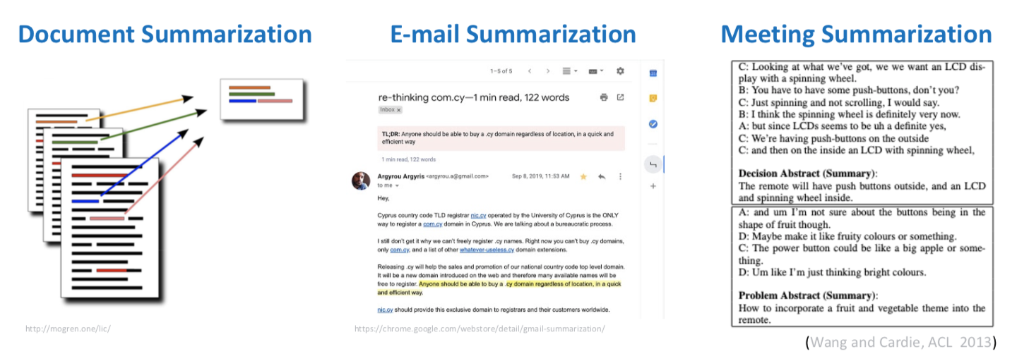
NLG Example – Language Generation
Notes:
Here are examples of the language generation task for document, email and meeting summarization.

Slide 13
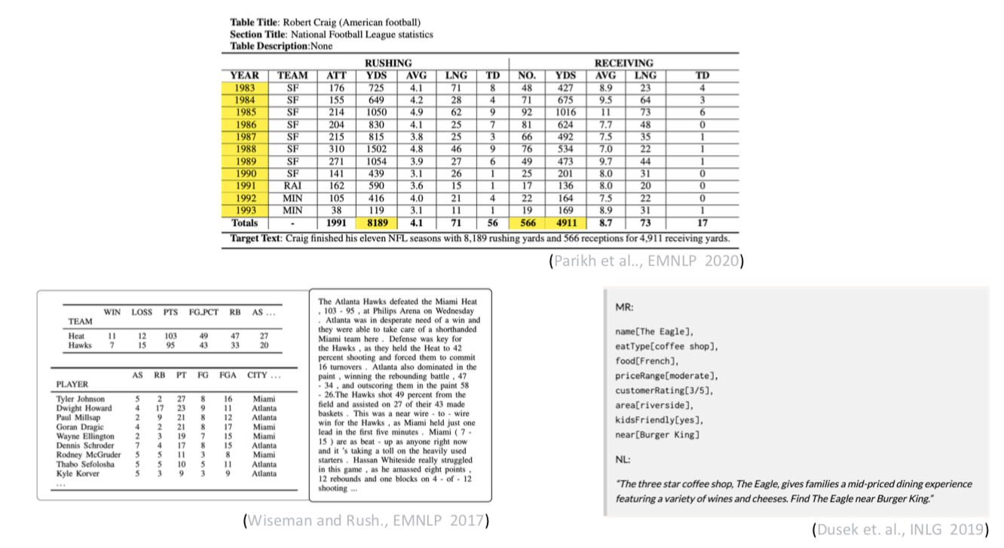
NLG Example – Language Generation
Data-to-Text Generation
Notes:
This is an example for the Data-text generation

Slide 14
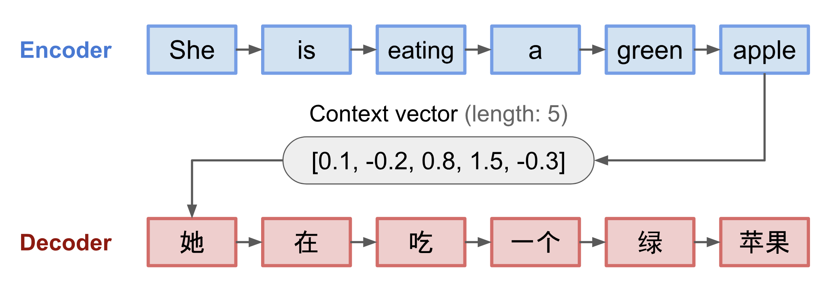
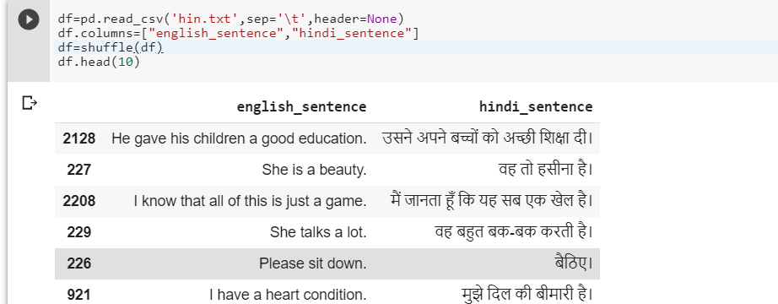
NLG Example – Machine Translation
Notes:
An example of translation.

Slide 15
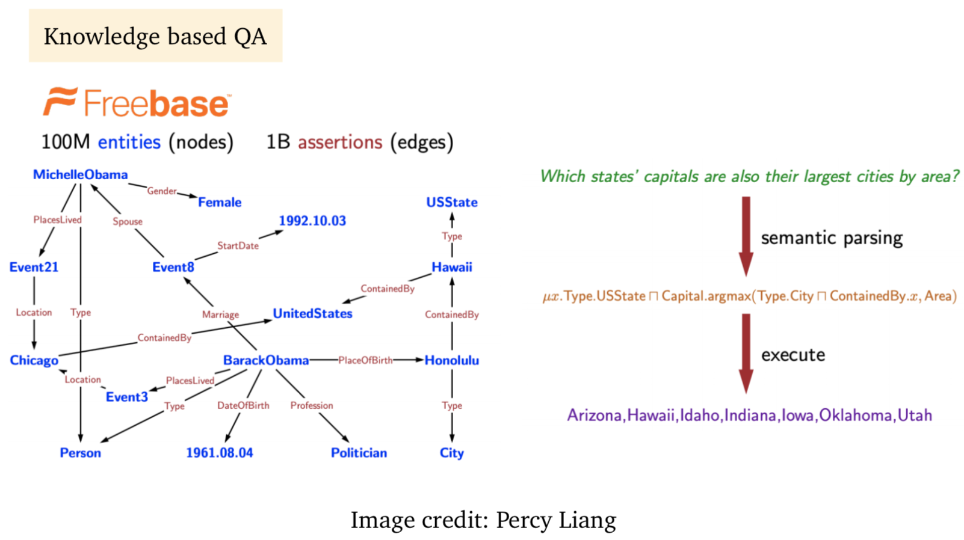
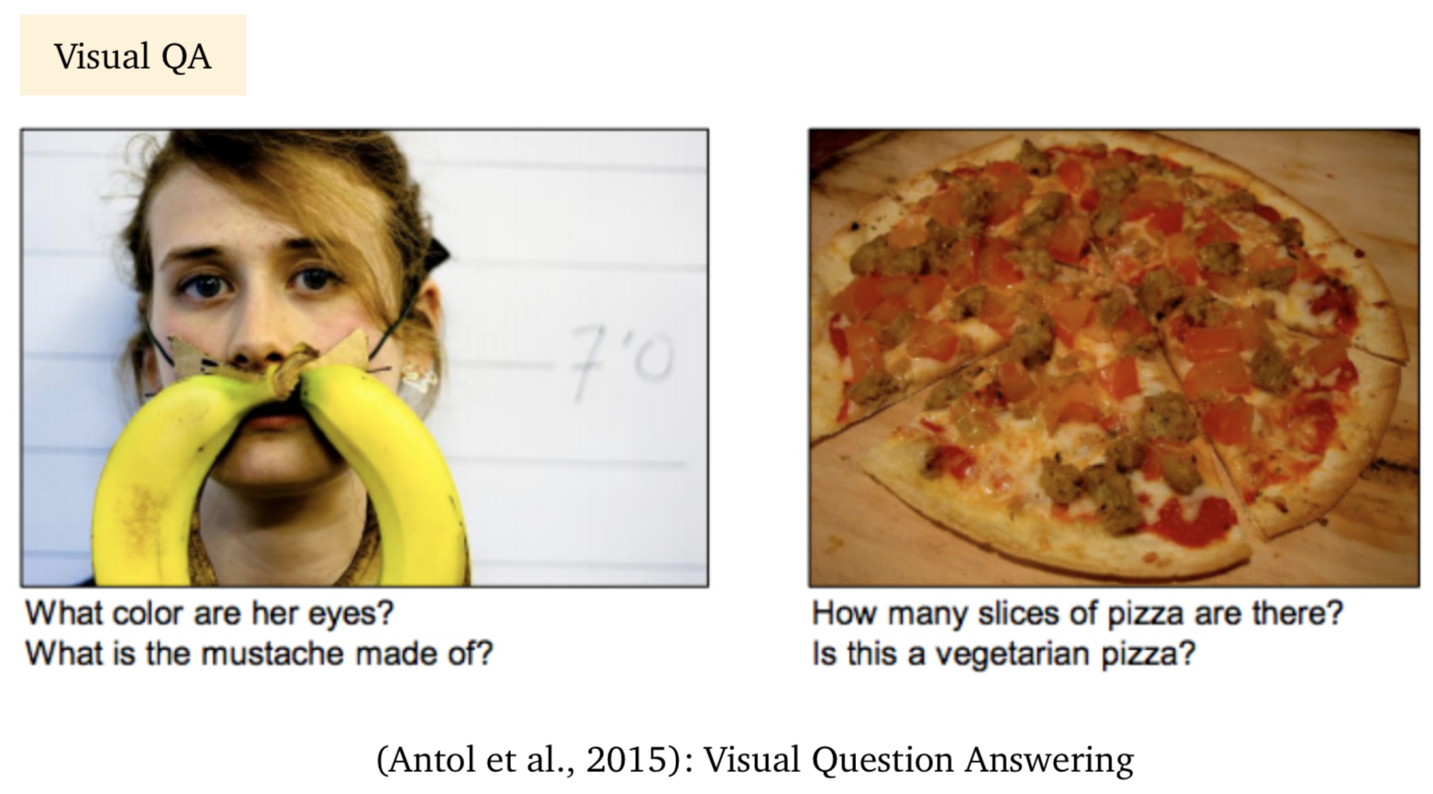
NLG Example – Question Answering
Notes:
Then our most familiar task, the QA. The two examples are for a enhanced QA task, we will talk about the visual QA for the multimodal topic.

Slide 16

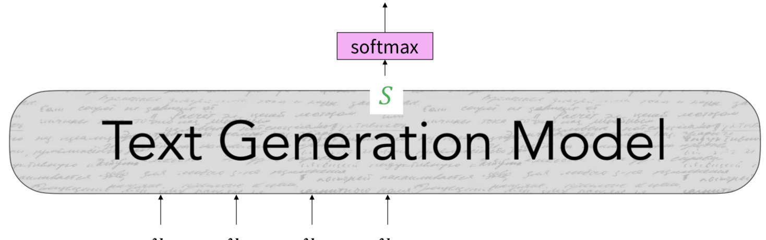
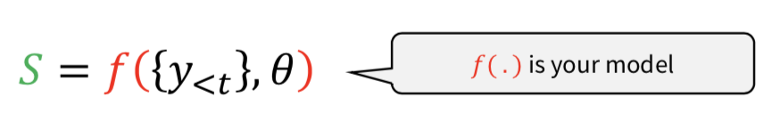
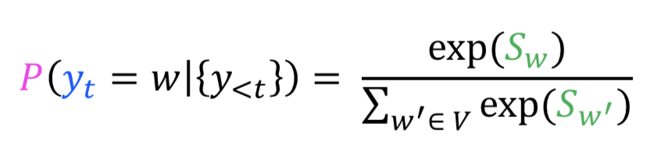

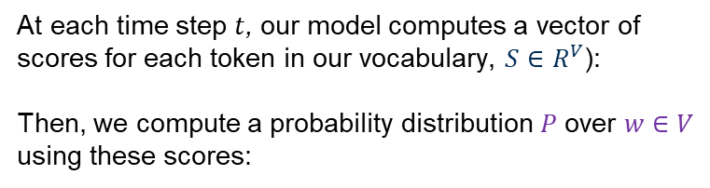
Text Generation – Next Word Prediction
At each time step $t$, our model computes a vector of scores for each token in our vocabulary, $S∈R^{V}$):
Then, we compute a probability distribution 𝑃 over 𝑤 ∈ 𝑉 using these scores:
Notes:
Now that we’ve seen how transformers work, let’s talk about how they learn generation with some math. It turns out that text generation is just next-word prediction. At each step, the model looks at all the words it’s already generated, and tries to guess what comes next.
At each time step t, the model:
Takes in all previously generated tokens: {y₁, y₂, ..., yₜ₋₁}
Computes a score for each word in the vocabulary — we call that vector S
Converts those scores into probabilities using the softmax function.
Here's the math:
S = f({y₁, ..., yₜ₋₁}, θ)
→ This is your model’s output — a vector of scores for each word
P(yₜ = w | {y₁, ..., yₜ₋₁}) = exp(S_w) / Σ₍w′₎ exp(S_w′)
→ This turns the scores into probabilities over all possible next words. The right hand side is how the softmax looks like

Slide 17
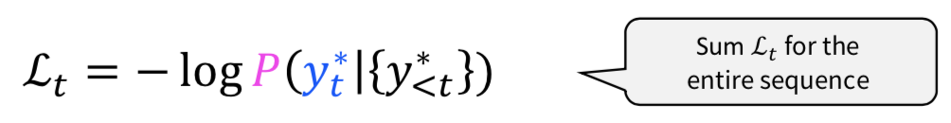
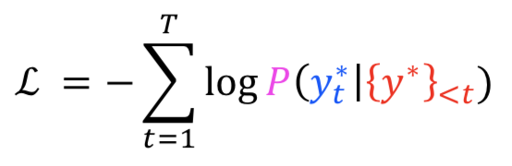
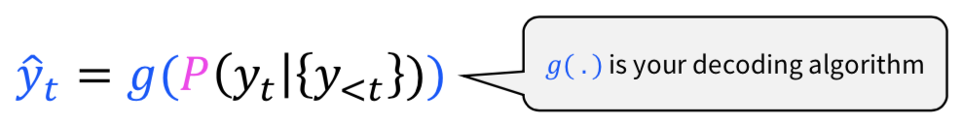
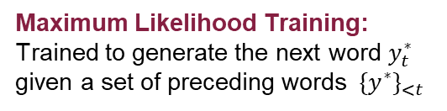
Text Generation – Train the Model
We train the model to minimize the negative loglikelihood of predicting the next token in the sequence:
Maximum Likelihood Training: Trained to generate the next word $y_{t}^{∗}$ given a set of preceding words ${ \{y^{∗}\}}_{<t}$
At inference time, our decoding algorithm defines a function to select a token from this distribution:
Notes:
We know we are try to make prediction. But how is the model learn from the iterations of predictions? Here is how the model be trained. The goal is simple: we want to train the model to maximize the probability of predicting the correct next word from the training data.
The process is all about measuring how "wrong" the model is and then nudging it in the right direction. This "wrongness" is calculated using a loss function.
1st equation: Loss at Each Step: For every single word in a sequence, we check how well the model predicted it given the words that came before. The formula, called the negative log-likelihood, gives us a "loss" or "error score" for that single prediction. If the model was very confident about the correct word, the loss is low. If it was surprised, the loss is high.
2nd equation: Total Loss for a Sequence: We then add up the individual loss scores for every word in the sentence to get a total loss for that entire training example.
3rd equation: After training, when we ask the model to write something, it no longer sees the "right answer." It uses what it learned to predict a probability distribution for the next token, and a decoding algorithm (g) chooses a word from that distribution.

Slide 18
Language Model Architectures
Encoder-Only Models
Example: BERT-based models
Use Case: Tasks that require a deep understanding of input data. These models are effective for classification, sentiment analysis, and information extraction.
Large Language Model is “Large”:
Trained on massive corpora of text data
Large number of parameters (often billions or even trillions)
Decoder-Only Models
Example: GPT, XLNet
Use Case: Generative tasks. They work by predicting subsequent text based on the provided context in an auto-regressive fashion. Their primary function is output generation without a separate encoding phase.
Encoder-Decoder Models
Example: T5, BART
Use Case: Tasks that involve both understanding and generating data. They first encode an input sequence into an internal representation and then decode it into an output sequence.
https://medium.com/@yumo-bai/why-are-most-llms-decoder-only-590c903e4789
Notes:
Alright. We have learned the most famous transformer module and the generative task that LLM performs. However, encoder-decoder is not the only architecture that the language model use.
(read slides)

Slide 19
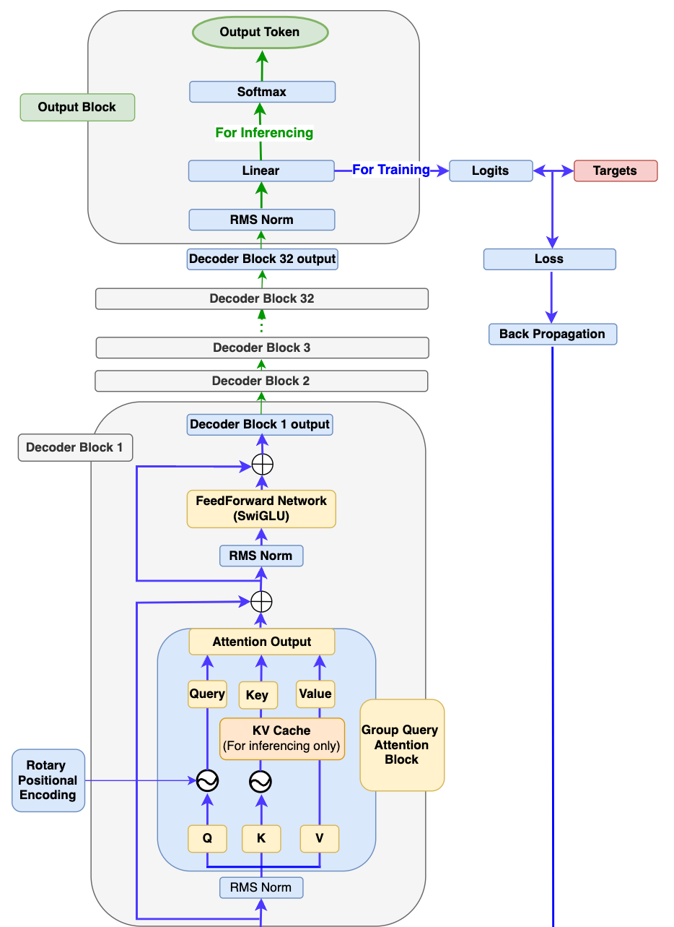
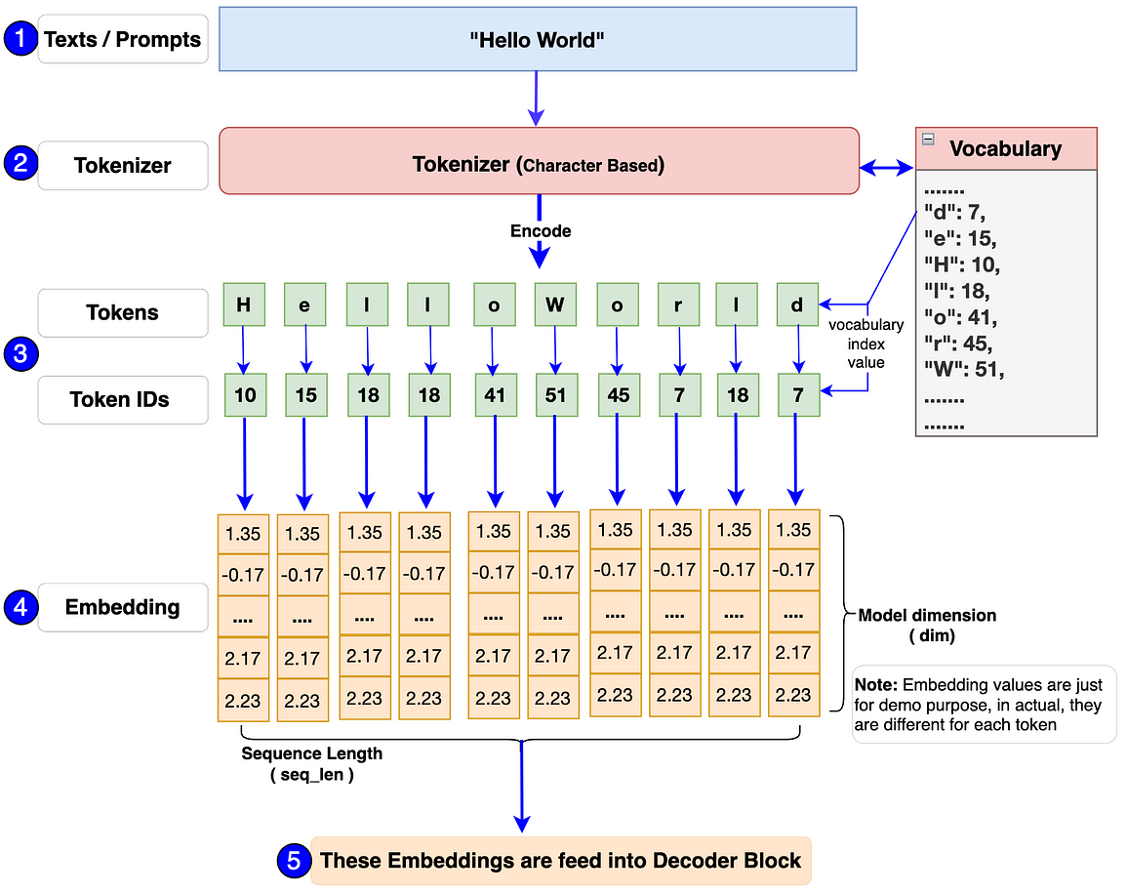
LLaMA
https://medium.com/@-0f7141c83d9e
Input Block
Notes:
This slide shows a real-world example of a decoder-only large language model — LLaMA, which is open-sourced and widely used in research today.

Slide 20
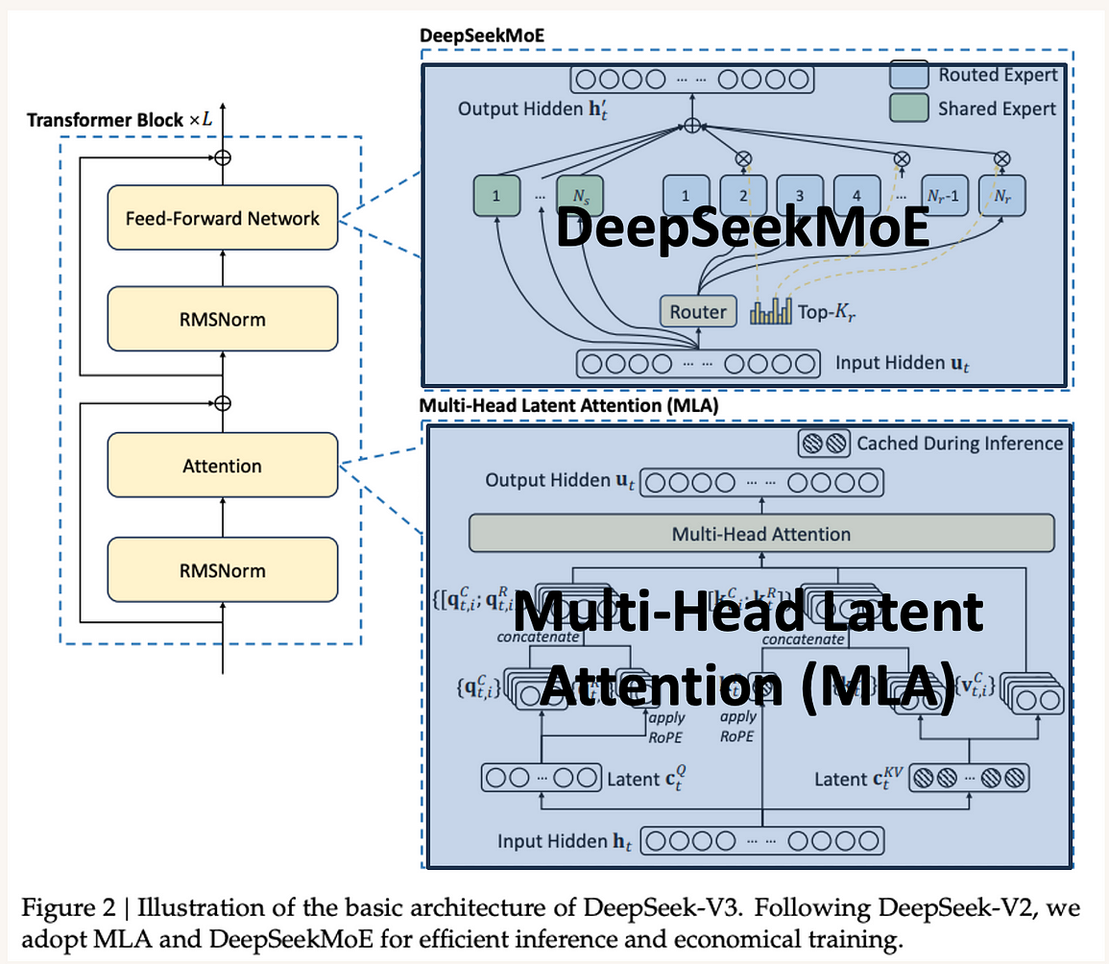
DeepSeek
Multi-head Latent Attention (MLA) Enhances attention mechanism for richer context understanding. Allows model to “focus” on different parts of input more flexibly
DeepSeekMoE (Mixture of Experts) Instead of one giant model, uses many smaller “experts”. Each “expert” specializes in certain types of knowledge or tasks. Model dynamically chooses which experts to use for each input
https://medium.com/@YanAIx/deepseek-v3-architecture-and-design-a3bafb9b2df6
Notes:
Here’s an example of an advanced decoder-only LLM — DeepSeek. It builds on the architecture we’ve seen before, but adds new innovations to make it smarter and more efficient.
(read slides)
So, you can think of DeepSeek as having a smarter attention system and a modular structure that saves compute by choosing the right tools for the job.

Slide 21
LLM with Mixture-of-Expert – Efficient and Powerful
Notes:
We just see the mixture of expert help the DeepSeek a lot. I will briefly introduce this comprehensively used new technique to improve the efficiency of model and the integration of multiple modalities.
This approach is a breakthrough because it allows us to build models with a vast number of parameters (more knowledge), while only using a small fraction of them for any given task. This improves efficiency and is a key technique for building state-of-the-art models, including those that handle multiple modalities like text and images.

Slide 22
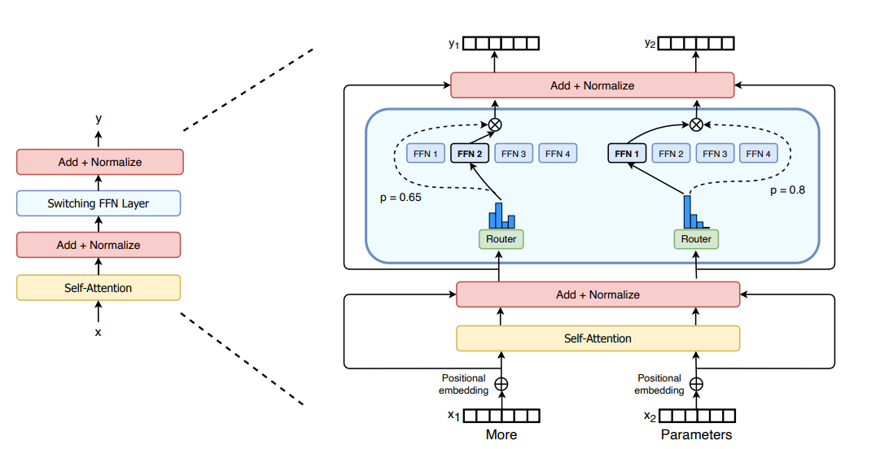
Mixture of Experts in Deep Learning
Single-expert motivated
Router distribute tokens based on relevance score between tokens and experts
Gating network choose which expert is suitable based on input
¹ Fedus, William, Barret Zoph, and Noam Shazeer. "Switch transformers: Scaling to trillion parameter models with simple and efficient sparsity." Journal of Machine Learning Research 23.120 (2022): 1-39.
Notes:
So, this is how the MoE model looks like. After all the encoding process, you can see the input goes into multiple FFN, every single token is processed by the exact same Feed-Forward Network (FFN).
So how does the model choose an expert? That's the job of the Router, also called a Gating Network. The router looks at each token and decides which expert is best suited to process it. It calculates a relevance score and sends the token to the most appropriate expert(s).
The core idea is that for each token, only a small subset of experts are activated. This is how MoE achieves huge efficiency gains. You will need far smaller GPU capacity to run the DeepSeek with the same size, which means same level of knowledge.

Slide 23
Evolution
Sparsely-Gated MoE
Transformer-based
MoE with Instruction
Hierarchical MoE
Two level granularity of experts
Random routing and expert capacity
Auxiliary loss and load balancing
Switch Transformers ¹
Selecting only one expert per token with highest gating score. (replace top-k)
Experts chose tokens ²
Experts to select top-k tokens. No auxiliary loss needed, which increase speed.
Soft MoE routing algorithm
Instruction Tuning ³
Instruction-tuned experts; Task-Specific Routing; Instruction-Aware Gating
¹ Fedus, William, Barret Zoph, and Noam Shazeer. "Switch transformers: Scaling to trillion parameter models with simple and efficient sparsity." Journal of Machine Learning Research 23.120 (2022): 1-39.
² Zhou, Yanqi, Tao Lei, Hanxiao Liu, Nan Du, Yanping Huang, Vincent Zhao, Andrew Dai, Zhifeng Chen, Quoc Le, and James Laudon. 2022. “Mixture-of-Experts with Expert Choice Routing.” arXiv [Cs.LG]. arXiv.
³ Shen, Sheng, et al. "Mixture-of-experts meets instruction tuning: A winning combination for large language models." arXiv preprint (2023).
Notes:
What you just seen is the fundamental approach of the MoE, there are many works developed based on it to further improve the performance.

Slide 24
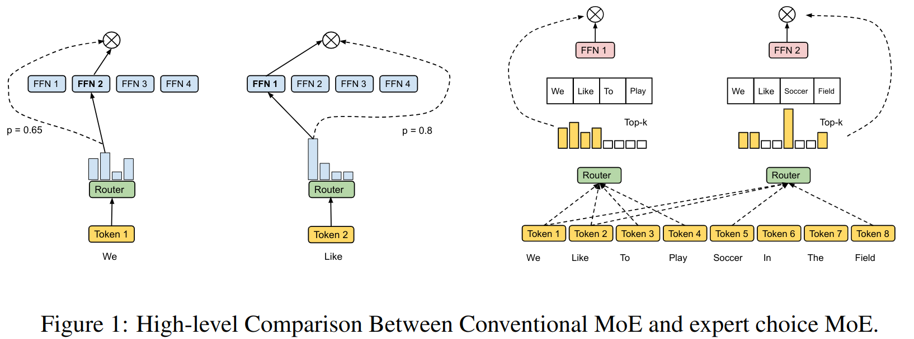
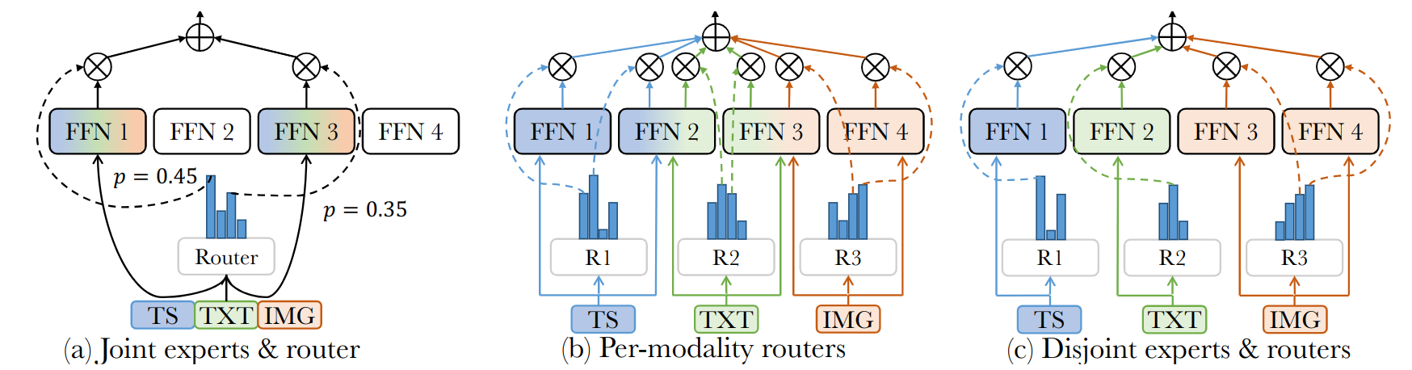
Possible Experts & Routers
Notes:
The key component of the MoE model is the router. Let's explore two advanced aspects of how it can be designed.
In the top figure, there are two main categories for how the router can assign tokens to experts.
Token Chooses Expert (The Standard Way): This is the method we've been discussing. Each token acts independently. The router looks at a single token and decides which of the available "specialist" experts is the best fit for it. \
Expert Chooses Token: Instead of tokens choosing experts, the experts choose the tokens. Here, each expert gets to scan all the incoming tokens in a batch and "claim" the top tokens it is most specialized to handle.
Mixture of Experts is especially powerful when a model needs to handle multiple types of data at once, like text, images, and audio. This is called multimodality. The bottom figure shows a few ways we can design the router and experts for this.
Joint Router: All data, regardless of whether it's a piece of an image or a word from a sentence, is first mixed together. Then, a single, shared router directs this mixed traffic to a shared pool of experts. The experts need to be generalists that can handle any type of data thrown at them.
Per-Modality Router: Each modality gets its own dedicated router. So, there's a "text router" for text and an "image router" for images. However, both of these routers send their data to the same shared pool of experts. This allows the experts to learn from all types of data, potentially finding interesting connections between them.
Disjoint Router (VIP Service): This is the most specialized setup. Here, everything is separate. Each modality gets its own dedicated router and its own private team of experts. The text experts only ever see text, and the image experts only ever see images. They are true specialists that never cross over.

Slide 25
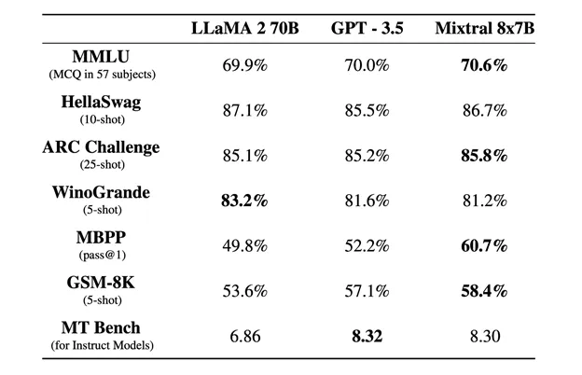
Advantages
More efficient: mixtral-8x7B ¹ outperform GPT-3.5 and Llama-2-70B
Dynamic Specialization of Experts (No rules needed)
Flexible to take arbitrary number of modalities and can be run with both unimodal and multimodal
Can choice the trade-off between Modality interaction and modality Specific information learned
¹ Jiang, Albert Q., et al. "Mixtral of experts." arXiv preprint arXiv:2401.04088 (2024).
Notes:
The advantages of MoE is not just the efficiency.
(read slides)

Slide 26
Trade-off in Router
Modality Specific feature
Inter-modality Information
Disjoint Experts & Routers
Modality Specific Routers
Joint Experts & Routers
Router i
Router t
Router i
Router t
Router
Expert 1
Expert 2
Expert 3
Expert 1
Expert 2
Expert 3
Expert 4
Expert 1
Expert 2
Expert 3
Notes:
In the multimodality case, the selection of the routing strategy is a trade-off between the commonality and the specificity we want the model to learn from the multiple data sources. So, the choice of router design depends entirely on your goal. There is no single "best" answer. You have to ask:
Is it more important for my model to have a deep, specialized understanding of each separate modality? (Choose a Disjoint design for more specificity).
Or is it more important for my model to find the high-level, abstract connections between the modalities? (Choose a Joint design for more commonality).
The Per-modality Router often serves as a practical compromise, trying to achieve a balance between both.

Slide 27
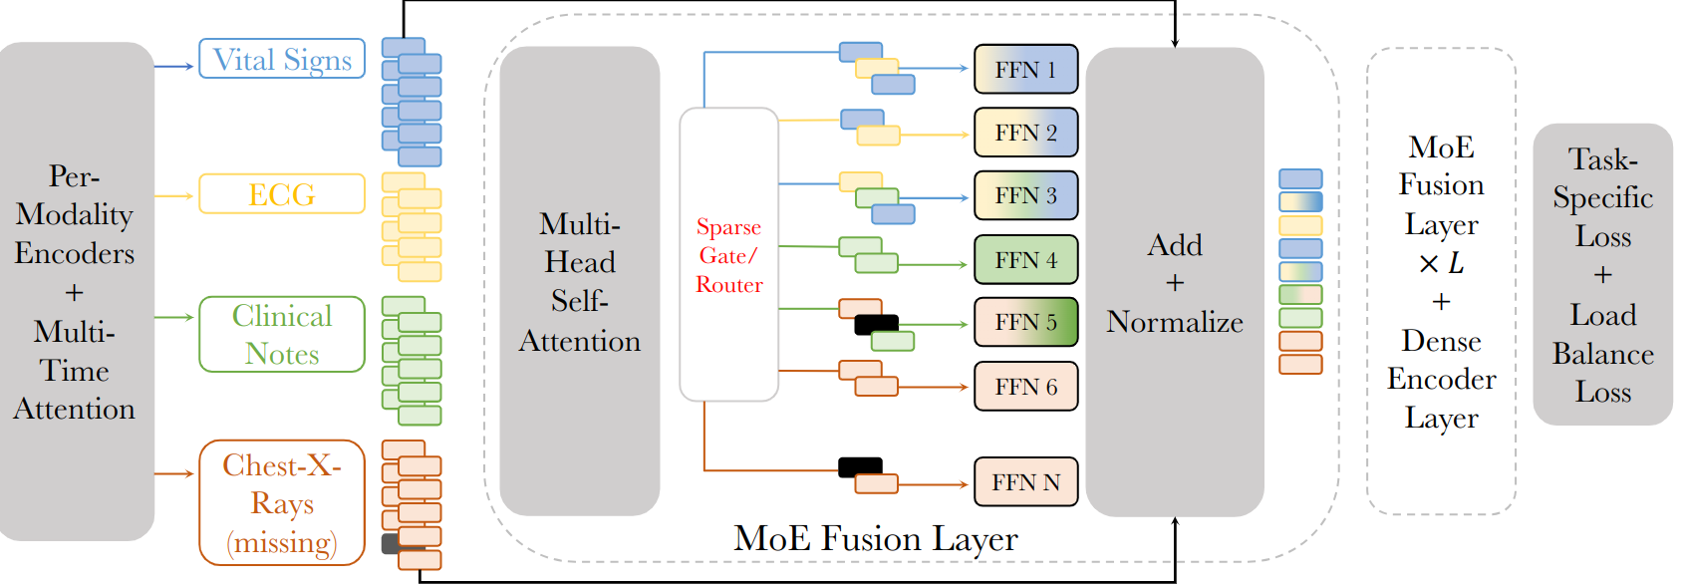
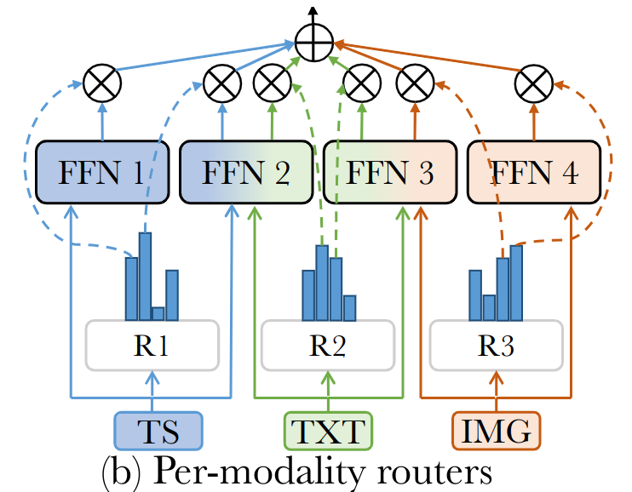
FuseMoE – BioMedical Multimodal MoE
weighted through a gating
function, resulting in fused embeddings
Notes:
For example, this is a recent published FuseMoE – BioMedical Multimodal MoE ​.

Slide 28
Multimodal LLM – Multimodal is how people seen the world
Notes:
We have already see the example of multimodal and how MoE handle it. The multimodality is actually how human beings feel and learn the world. Let’s see how Large language model handle the multimodality.

Slide 29
LLM can Read and See
What are Multimodal Large Language Models?
Multimodal Large Language Models (MM-LLMs) extend traditional LLMs by integrating additional modalities—such as images, audio, and video—alongside text. This allows the models to understand, reason about, and generate content that spans multiple types of data, not just language.
For example, an MM-LLM can:
Comprehend and analyze combinations of text, images, and audio within a video
Generate textual descriptions (captions) for images or videos
Create images or videos from text prompts or combine audio narration with visuals
Notes:
What are Multimodal Large Language Models?​
It extend traditional LLMs by integrating additional modalities alongside text. This allows the models to understand, reason about, and generate content that spans multiple types of data, not just language.​
For example, an MM-LLM can:​
Comprehend and analyze combinations of text, images, and audio within a video​
Generate textual descriptions (captions) for images or videos​
Create images or videos from text prompts or combine audio narration with visuals​

Slide 30
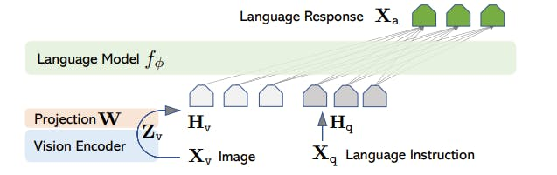
LLaVA: Large Language and Vision Assistant
LLaVA relies on the pre-trained CLIP visual encoder for visual content processing.
2. The visual features are connected to language embeddings through a trainable projection matrix
1. The encoder extracts visual features from input images
This projection effectively translates visual features into language embedding tokens, thereby bridging the gap between text and images.
LLaVA utilizes the LLaMA model, which is open-source language-only LLM
Liu, Haotian, et al. "Visual instruction tuning." Advances in neural information processing systems 36 (2023): 34892-34916.
Notes:
Alright, now let's look at a very influencial Multimodal Large Language Model: LLaVA, which stands for Large Language and Vision Assistant.
LLaVA relies on the pre-trained CLIP visual encoder for visual content processing. CLIP is ised to process the input image. Its entire job is to look at an image and extract the important visual features—the concepts, objects, and relationships within it.
The visual features from CLIP are in a numerical format that the text-based LLaVA model can't understand directly. They need a translator. That's the job of the Projection Matrix (W). a small, trainable layer that acts as a bridge. Its one and only purpose is to translate the visual features into the same 'language' as the text embeddings.
Now, the Language Model receives a combined sequence: The translated visual tokens from the image (H v). The regular text tokens from the language instruction (H q). From the LLaVA model's perspective, it's just getting a single prompt. It doesn't know one part came from an image and one from text; it just sees a coherent sequence of tokens. It then uses its powerful language understanding and reasoning abilities to process this combined prompt and generate a final textual response (X a).

Slide 31
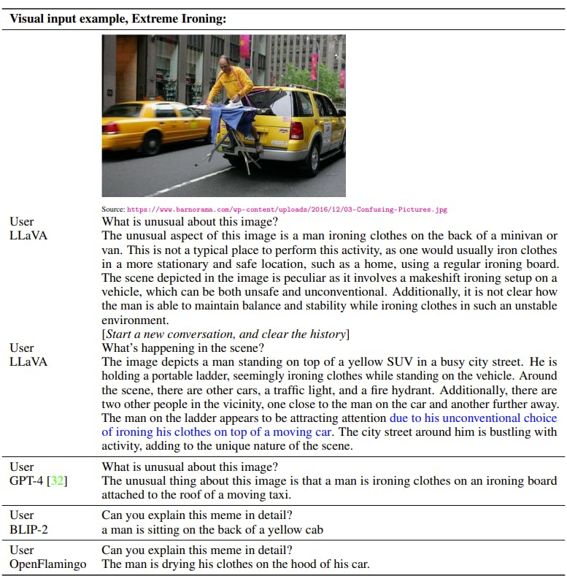
LLaVA Example
https://encord.com/blog/llava-large-language-vision-assistant/?utm_source=chatgpt.com
Notes:
Then, here is an example of how LLaVA works.

Slide 32
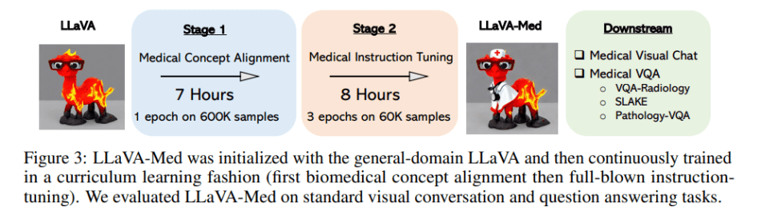
LLaVA-Med – LLaVA for Healthcare
Stage 1: Medical Concept Alignment (Pretraining)
In this stage, the model is exposed to a huge dataset of biomedical images and their captions, called PMC-15M.
Goal: The model learns the general language of biomedical images—what things are called and how they’re described.
Stage 2: Medical Instruction Tuning (Domain-specific Fine-tuning)
After building up this general knowledge, the model is fine-tuned with instruction-following tasks. (QA pairs based on real biomedical problems)
Notes:
This is a real-world application example of the LLaVA, which is called LLaVA-Med.
(read slides)

Slide 33
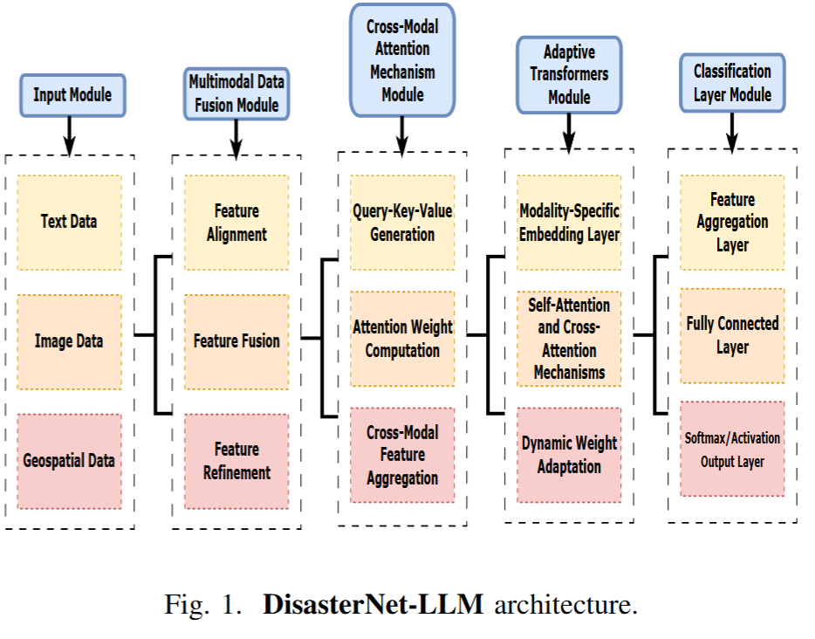
DisasterNet-LLM for Multimodal Disaster Classification
Notes:
Here is another example, which is an application of multimodal LLM in the agriculture field for the disaster forecasting. A major challenge in predicting these events is that we have satellite images, weather data, news reports, and even social media posts. Traditional methods struggle to combine all of these sources into one holistic picture. This paper, published just last month, proposes a solution called DisasterNet-LLM.
As you can see from the architecture diagram, the input module takes raw data from multiple data sources, then the multimodal data fusion step align and combine them together into a common format embedding. The cross-modal attention, figures out the relationships between different data types. We will explain this later. The adaptive transformer allows the model to dynamically change its focus depending on the specific type of disaster its seeing. Finally, the classification layer will give you the softmax probability to determine which event it is.

Slide 34




DisasterNet-LLM – Cross-Attention
GPT
R ^{Nxdt}
Text
R ^{(N+M+L)xd}
CLIP
R ^{Mxdi}
Image
Pairwise attention scores across text, image, and geospatial data.
NN-GLS
R ^{Lxdg}
Spatial data
Notes:
So, how does the Cross-Modal Attention Mechanism make sense of so many different data sources at once?
After the different data types—text, image, and geospatial—are converted into numerical embeddings, they are effectively concatenated into one large feature space. The attention mechanism then calculates a 'relevance score' between every single piece of information. It measures how relevant a specific word in a news article is to a specific pixel in an image or a specific set of GPS coordinates. This allows the model to understand, for example, that the word 'flood' in a text report is highly relevant to low-lying areas in the geospatial data and specific visual cues in an image. It’s this cross-referencing that allows for a holistic understanding of the event.

Slide 35
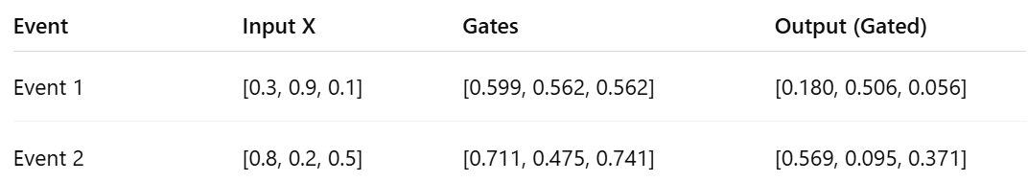
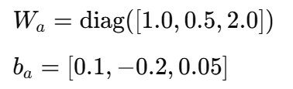

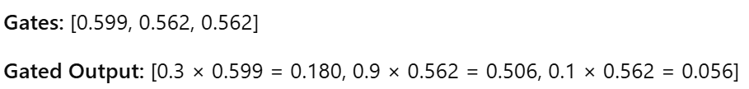


DisasterNet-LLM – Cross-Attention
 | Image | Text | Spatial
X1 | 0.3 | 0.9 | 0.1
X2 | 0.8 | 0.2 | 0.5
Notes:
Now, not all data is equally important for every disaster. The model needs to adapt its focus, which it does using the Adaptive Transformers Module.
This module uses a gating mechanism to dynamically adjust the 'weight' or 'importance' of each modality for every unique event. Let's walk through the example on the slide. We have two different events. Let's say Event 1 is a flood, where the text report is very clear and important (value of 0.9). Event 2 is a wildfire, where the satellite image is the most critical piece of data (value of 0.8).
For Event 1 (the flood), the model calculates 'gates,' which are like volume knobs for each data type. The model learns the high value of the text information. But for Event 2 (the wildfire), notice that the model computes a different set of gates: [0.711, 0.475, 0.741]. It has learned to turn up the importance of the image feature and turn down the text feature.
This shows the model isn't using a fixed recipe. It intelligently adapts and focuses on the most relevant data for the specific disaster it's analyzing, which is key for accurate prediction.

Slide 36
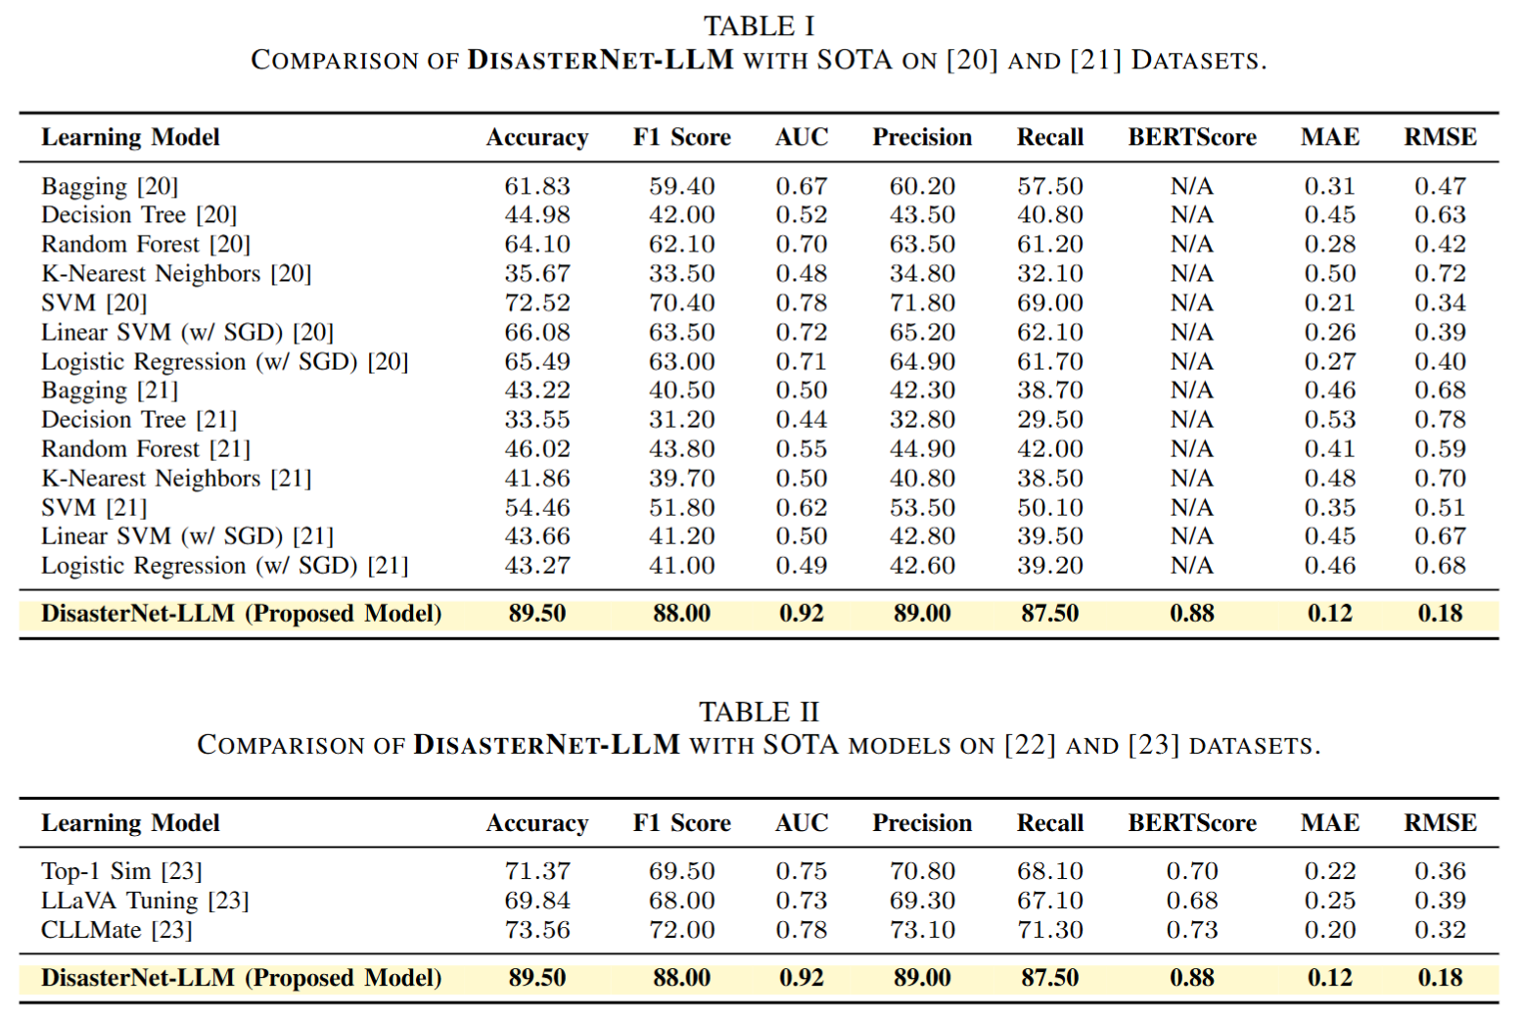
DisasterNet-LLM – Results on Classification
Notes:
The authors first tested DisasterNet-LLM against other State-of-the-Art (SOTA) models on two large, image-based disaster datasets. These datasets categorize images of things like fires, floods, and infrastructure damage. The baseline models in this table are mostly traditional machine learning methods like Decision Trees and Support Vector Machines (SVM). You might heard them if you have taken a machine learning course.
As you can see in the bottom row, the results are not even close. DisasterNet-LLM achieves an accuracy of 89.5% and an F1-Score of 88.0%. This demonstrates a massive improvement in the model's ability to correctly classify disasters.

Slide 37
DisasterNet-LLM – Results on Event Summarization
Notes:
Next, the researchers tested the model on datasets that are more complex and highly relevant to us: a meteorological dataset with weather variables and a large environmental news dataset. Here, DisasterNet-LLM was compared against more modern, LLM-based models. Once again, it significantly outperforming the other models.

Slide 38
LLM Application – Real-world Challenges
Notes:
Now that we've seen how powerful these models are, let's discuss some of their real-world challenges.

Slide 39
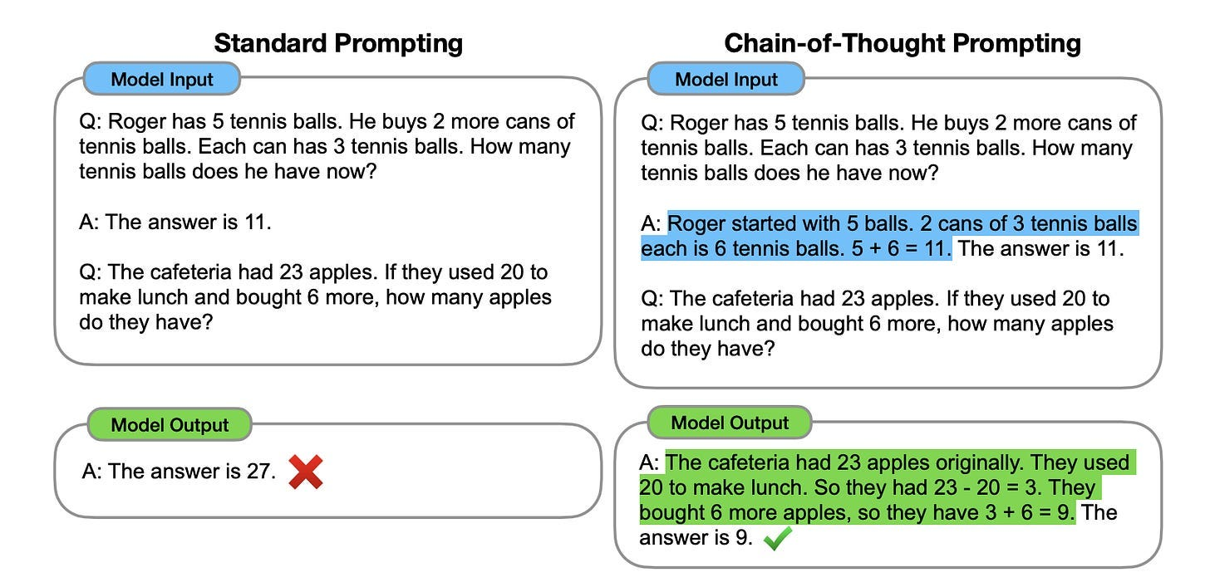
Hallucination – CoT
https://levelup.gitconnected.com/lets-talk-about-llm-hallucinations-9c8dab3e7ac3
Notes:
The first, and perhaps most famous, is the problem of hallucination. A hallucination is when an LLM generates text that is factually incorrect, nonsensical, or completely disconnected from the provided context. It's important to remember the model isn't 'lying'—it has no intent. It's simply a failure in the generation process where the model predicts a sequence of words that seems probable based on its training data, but isn't factually true.
Let's look at the example on the slide. We have a math problem that requires logical steps. With a standard prompt, the model gets it wrong when use single step.
One technique to improve this, shown on the right, is Chain-of-Thought (CoT) prompting. By simply asking the model to 'think step-by-step,' we force it to lay out its reasoning, which often leads to the correct answer.
But Chain-of-Thought only helps if the knowledge is already inside the model. What happens if the information is too new, specialized, or private for the model to know?

Slide 40
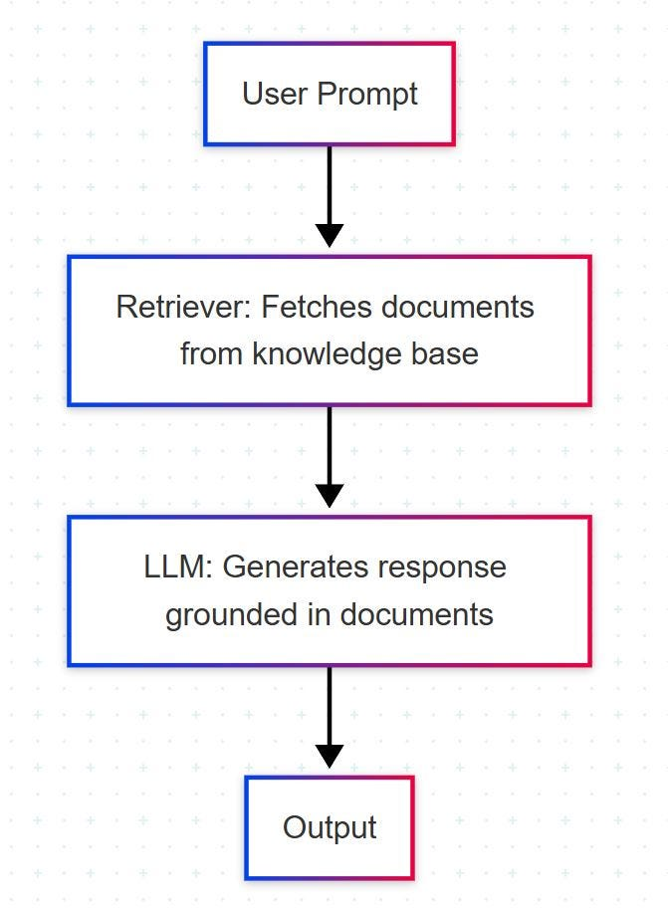
Hallucination – RAG
Retrieval-Augmented Generation (RAG) combines LLMs with a retrieval system that fetches relevant documents from a knowledge base before generating responses.
Notes:
Then, we use a technique called Retrieval-Augmented Generation, or RAG. RAG grounds the LLM in facts by connecting it to an external knowledge base. Think of it as giving the LLM a textbook and forcing it to look up the answer before speaking.
Here's how the workflow on the slide operates:
First, a user provides a prompt.
Instead of going directly to the LLM, the system sends the query to a Retriever. The Retriever is like a super-fast librarian that searches a specific knowledge base—this could be recent scientific papers or a company’s internal document, and fetches the most relevant documents.
The system then 'augments' the original prompt, combining the user's question with the related information it just retrieved.
Finally, this augmented prompt is sent to the LLM, which now generates a response that is grounded in the provided documents.
This process ensures that the model's answers are up-to-date and based on a verifiable source of truth, significantly reducing the risk of hallucination. Sometimes, you can also see the Chatgpt search on the webpage to grab the information.

Slide 41
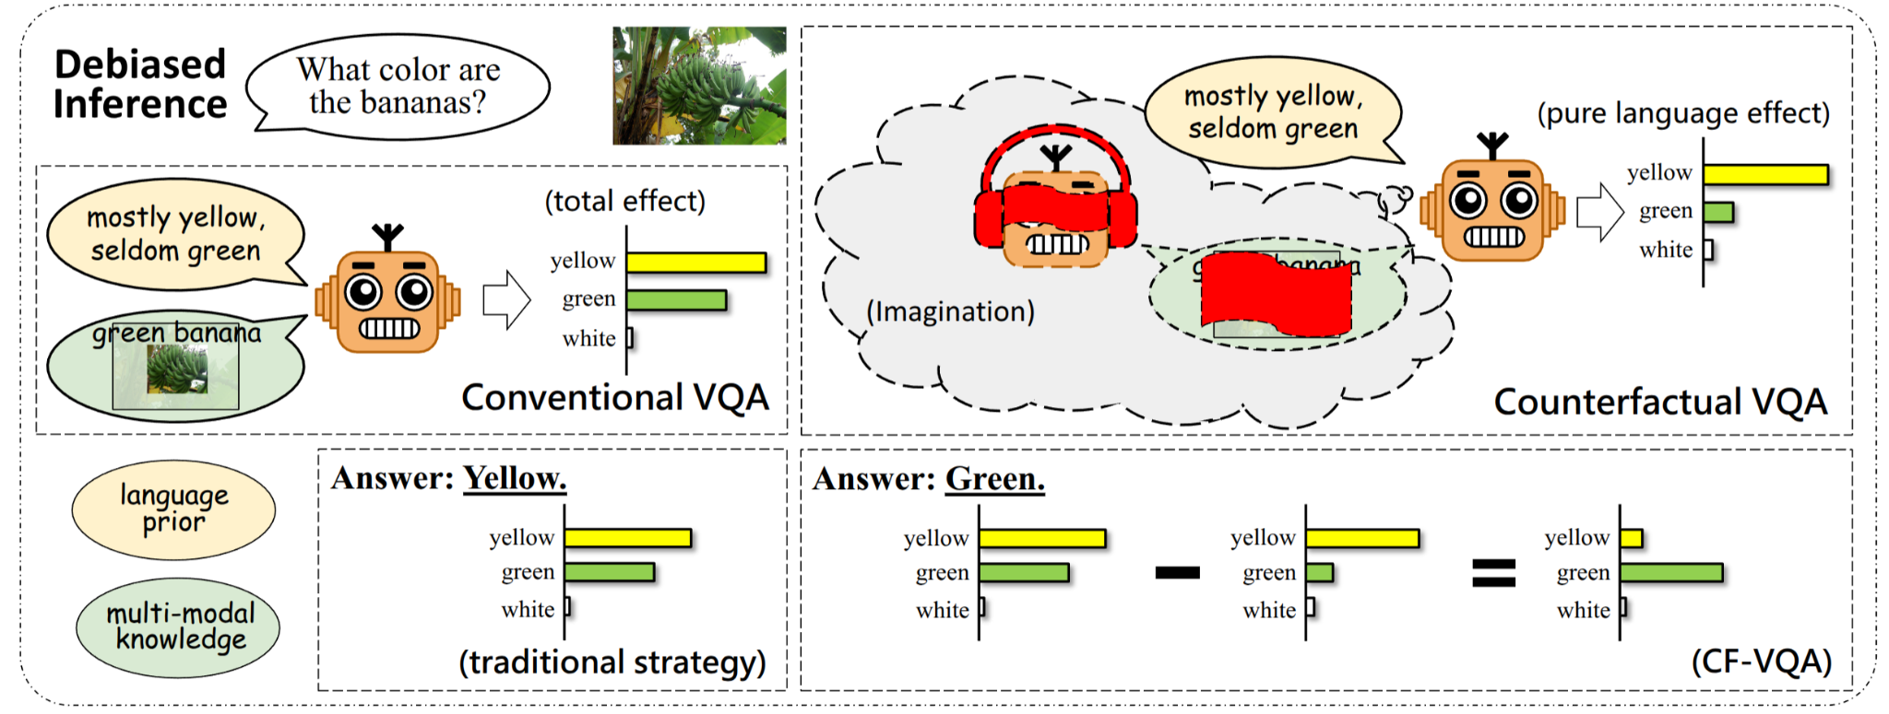
Multimodal Bias
What is multimodal language bias? The question alone causally drives the answer, causing models to ignore the image and fail on bias-sensitive test splits.
Answer based on question tokens
Answer considering image info
Notes:
The second major challenge is for the multimodal LLM, which is especially relevant for the multimodal models we've been discussing, is language bias. The problem is exactly what the description says: the question alone causally drives the answer. The model becomes so reliant on the statistical patterns in its text training data that it starts to ignore the visual information from the image.
The banana example on the slide is perfect for illustrating this: We show the model a picture of green, unripe bananas, We ask, "what color are bananas?", A biased model will answer "yellow."
Why? Because in the billions of sentences it was trained on, the association between 'banana' and 'yellow' is incredibly strong. This language-based shortcut is so powerful that it overrides the actual visual evidence in front of it. You can imagine the danger of this in an agricultural setting, where a model might misidentify a healthy crop as diseased simply because that crop type is frequently associated with disease in textbooks.

Slide 42
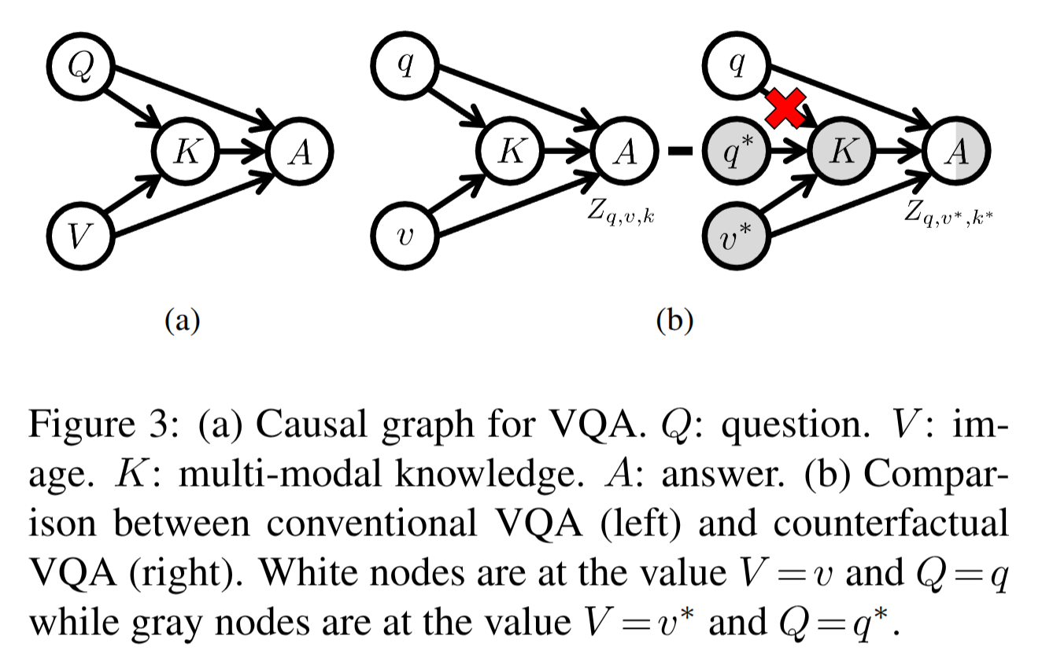
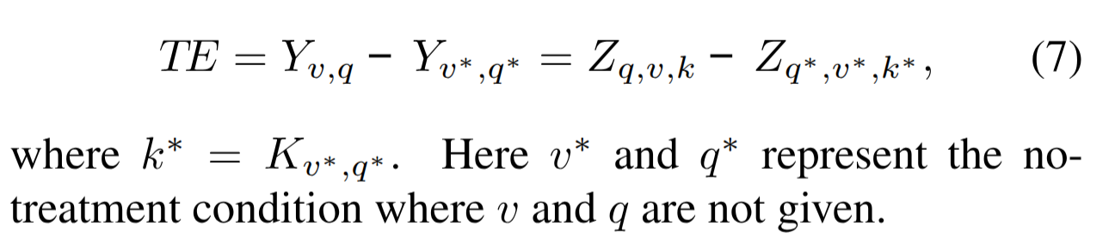
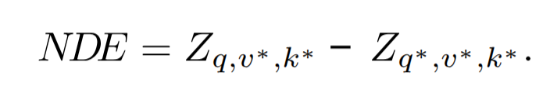
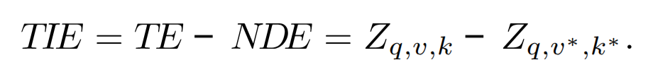
Multimodal Bias – Debiasing with Causal Inference
Pure Language Effect
Random guess
Re-write Y_{v, q} = Z _{q, v, k}
Natural direct effect = model cannot see image and multimodal embedding. (answer “yellow”)
Total Indirect Effect = Z _{q,v,k} - Z _{q,v*,k*} , Exclude the part model answered without look into the image, subtracting only biased part.
Notes:
So, how can we force the model to actually look at the image? One advanced solution comes from a paper called 'Counterfactual VQA,' which uses causal inference to measure and remove this language bias.
Let's break down the process shown in the figure.
Total Effect (TE): First, we measure the model's normal, 'biased' performance. We give it the real image (the green banana) and the real question. The biased answer is the Total Effect.
Language Bias (NDE): Next, we need to isolate the bias. This is the clever part. We give the model the real question, but a counterfactual image—a random, unrelated picture, like a car. If the model still answers "yellow" to "what color are bananas?" while looking at a car, we know that answer is coming 100% from language bias, because the image was irrelevant. This is called the Natural Direct Effect (NDE).
The Fix (TIE): Finally, we get the 'true' visual understanding of the model by subtracting the language bias (NDE) from the Total Effect (TE). During training, the model is penalized based on this bias, forcing it to pay less attention to the language shortcuts and more attention to the visual evidence to get the correct answer.
In short, this method figures out how much of the model's answer is just a 'lazy' language-based guess and subtracts that influence, forcing it to rely on what it actually sees."

Slide 43
Thank You !
Email: junh@vt.edu

Slide 44
References
https://python.plainenglish.io/attention-mechanism-in-a-large-language-model-unlocking-the-power-of-context-d797dc55f5e3
https://medium.com/data-science/the-large-language-model-course-b6663cd57ceb

Slide 45
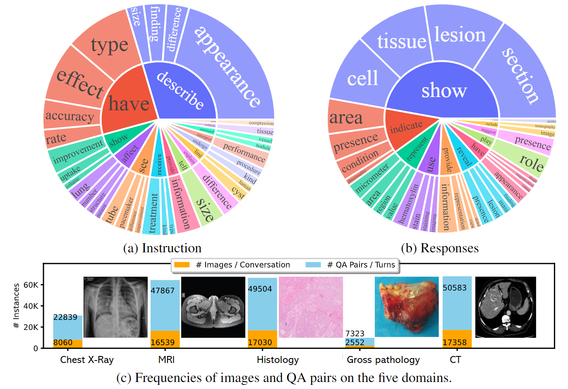
Data is Blood for LLMs
Types of tasks/questions the model is trained on, and what kinds of responses it produces.
Notes:
These figures from the LLaVA-Med paper illustrate the second step of training, where the model is fine-tuned to follow medical instructions and answer questions across a variety of image types. The first stage—alignment—uses figure-caption pairs, but the charts here show how richly the model is trained to handle different tasks and questions in biomedical images.

